Slide 1
VDSL RJ11 Connection diagram
KRISO
2017.04

Slide 2
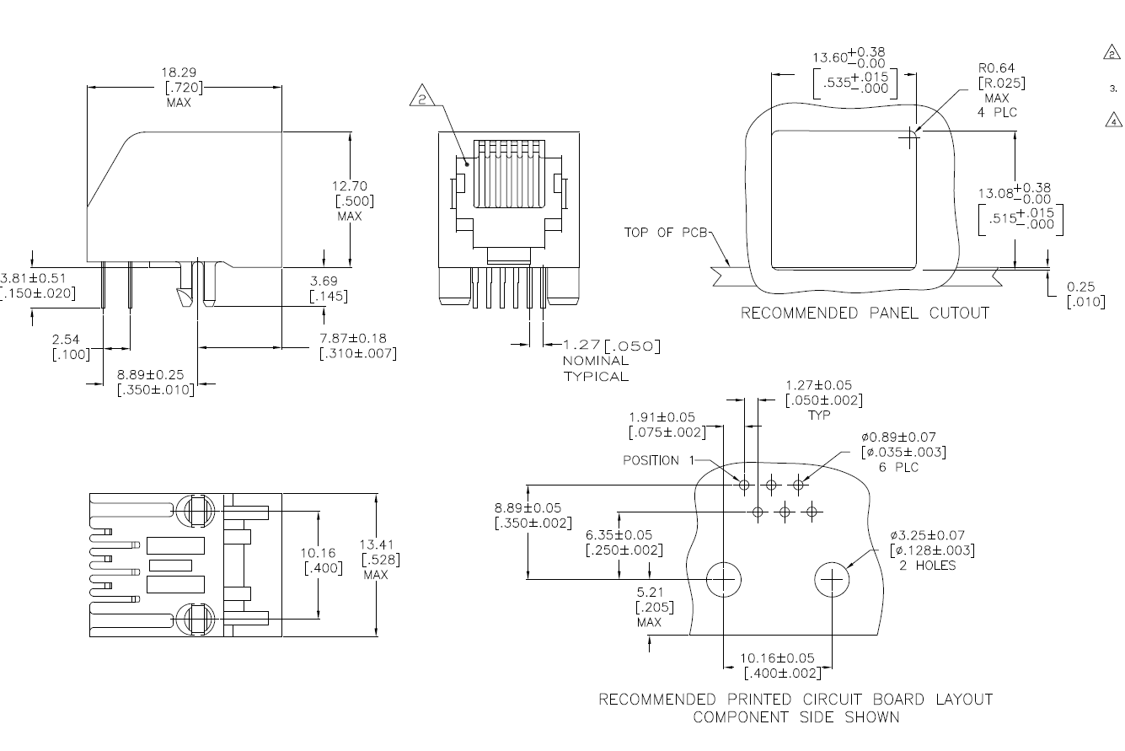
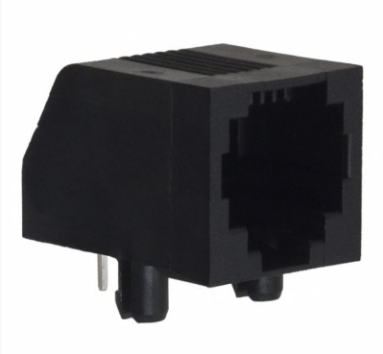
RJ11 Modular connector
Part number: https://www.digikey.com/products/en?keywords=A31443-ND%20
P1P
P1N
P1G

